Slide 1
Internal Communication
15. Anniversary Swiss Re Slovakia

Slide 3
Swiss Re Bratislava – a part of One Swiss Re story
Branch in Slovakia established in 2006
2nd biggest Swiss Re location
More than 1900 employees
15 years of Swiss Re Bratislava that represent growth, contribution to
business, making a difference and impact while learning, developing and
sharing knowledge.
Jana Riecanska, Martina Husarova | September 2021 | Employee Communication

Slide 4
Activities that were released from 1 until 26 October
1 October Nima Motazed’s video speech: Summary of activities
Unique fingerprint of each of us
From 1 – 21 October
Video Quiz: 15 questions in five videos by well-known people/partners of Swiss Re
+ prizes
BTS fingerprint in the group
21 October
Donation to the City of Bratislava in line with our sustainability & resilience strategy: 5-year care of Platan trees – leave a fingerprint in the community
01
02
03
04
05
06
21 October
BIG video – to show the growth, diversity, knowledge & dedication of our employees
Gifts to be distributed - fingerprint
26 October
GEC Talk with Moses, Anette and Guido, moderated by Nima Motazed and Petra Dornhofer
Fingerprint in the group
From 1 – 21 October Personal stories of 15+1 employees Fingerprint in indivdual BUs

Slide 5
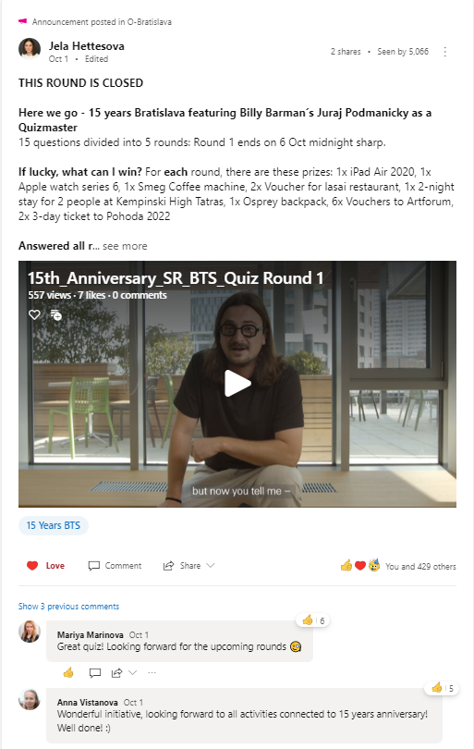
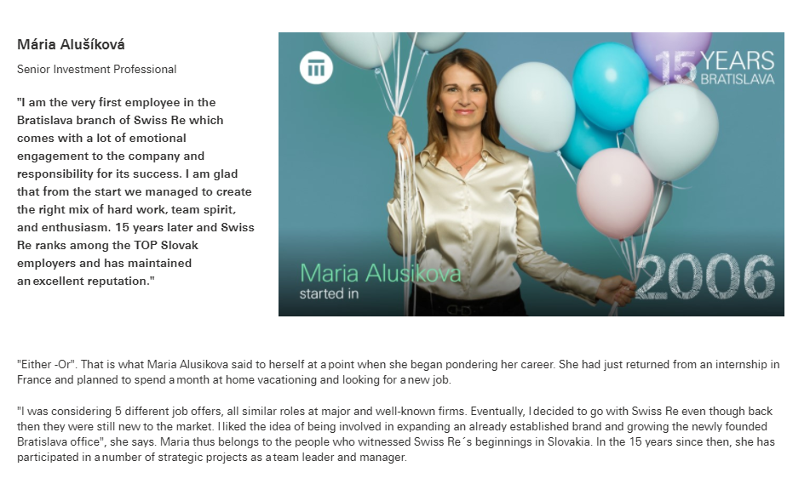
Nima’s message
Quiz with 5 rounds
15+1 Personal stories

Slide 6
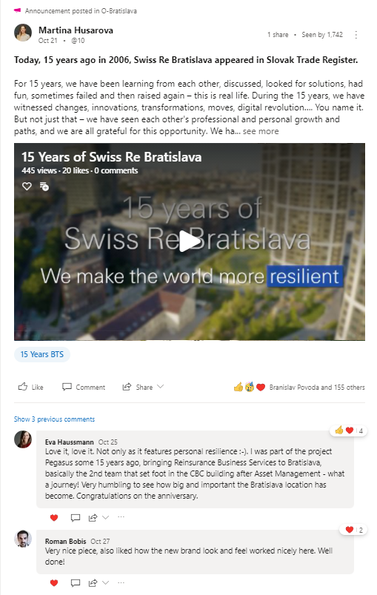
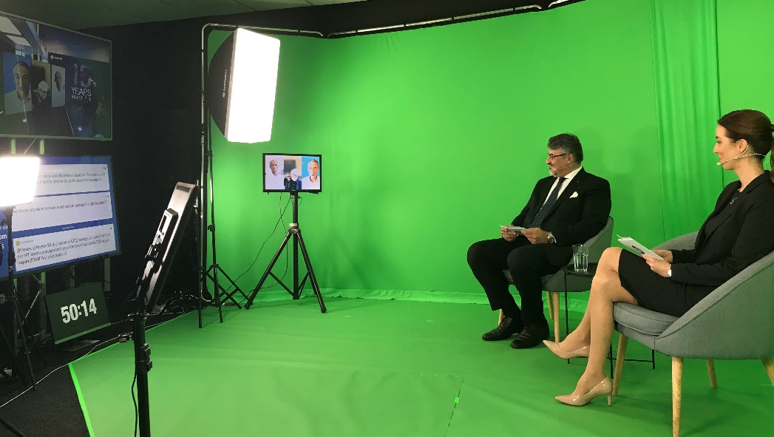
Donation to the City of Bratislava
GEC panel discussion
Big video – 15 Years Bratislava

Slide 7
Yammer posts
Sharepoint news posts
More than
3600 likes
More than
44 000 views
1 October
5338 Bratislava site visits
More than
8000
views
More than
50 comments
More than
450
likes
More than
30 comments
Quiz – 5 rounds
GEC Panel
approx. 600
participants in each round
1004 attendees asked
57 questions

Slide 8
Comments
15 Years Bratislava Video – 21 October
” Great job! Super-professional and touching at the same time, a great representation of Bratislava with spirit and professionality! “
Uwe Nagel, Chapter Lead Data Science Bratislava, Swiss Re
Nima’s video message – 1 October
” Congratulations to all who have help us to achieve this impressive milestone! I can only begin to imagine what the future holds - it will no doubt be very exciting. Also love the donation to the City of Bratislava! “
Warren Hunt, Head Financial Accounting Non Technical, Swiss Re
Donation to City of Bratislava – 21 October
” Great donation idea! I live nearby and the platan trees on Trnavske myto really changed the area. I love that Swiss Re is involved! “
Radmila Urbani Blazova, Senior Consultant, Business Solutions Bratislava, Swiss Re

